Slide 1
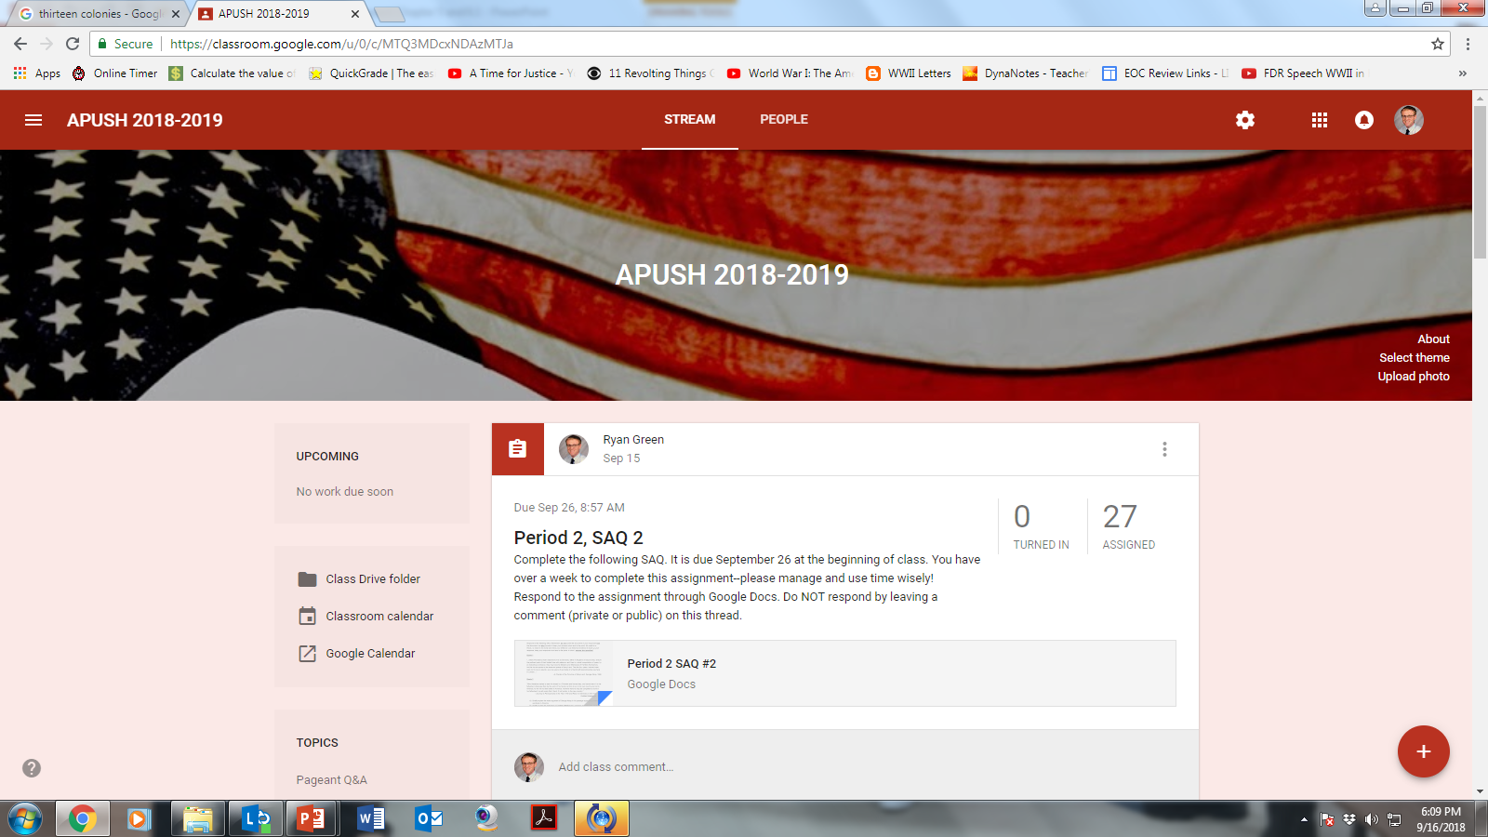

Slide 2
And That’s Period 2!
Period 1: 1491-1607
Period 2: 1607-1754
Test! (9-25)
Period 2 HIPP (due 9-25)
BAGPIPE (due 9-25)
Google Classroom SAQ 2 (due 9-26)
Period 2 Summary (due 9-26)

Slide 3
Colonial America Pre-Revolution and The Duel for North America
The American Pageant,
Chapter 5 and Chapter 6.1

Slide 4
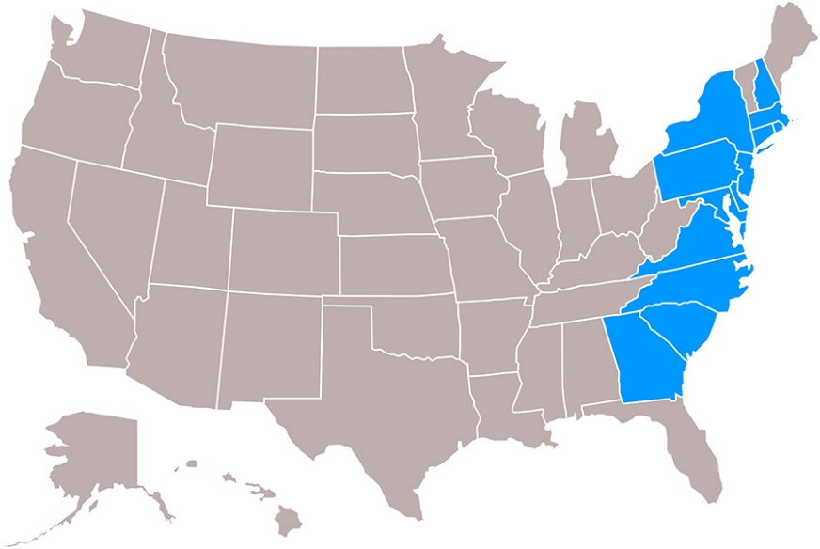
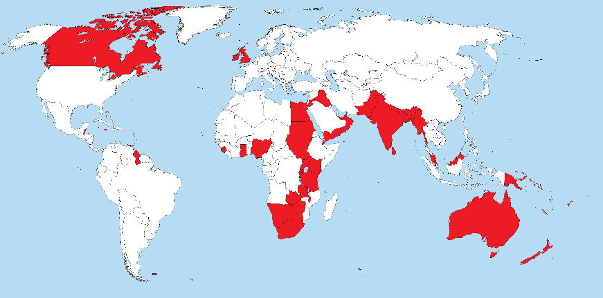
Who Makes Up The Thirteen Colonies?
Misleading term!
“The sun never set on the British Empire”
By 1700
300,000 inhabitants
20,000 Africans
By 1775
2,500,000
500,000 Africans
400,000 White immigrants
Increase in Population—why?
Immunity
Natural fertility
Consequences:
1) English subjects outnumber American colonists 20-1 → 3-1 by 1775

Slide 5
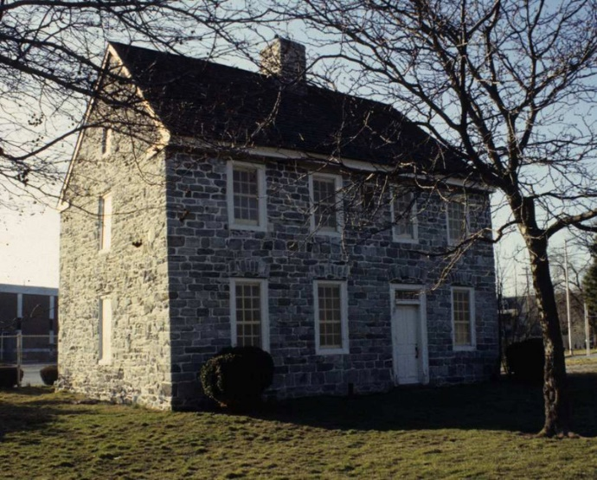
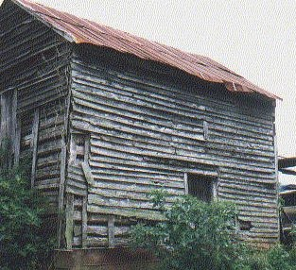
Mingling of Races
Push and Pull Factors
America becoming more of a melting pot
Primarily English and English-speaking, BUT…
Germans (150,000) settle in PA
Scots-Irish (175,000) settle in PA
Move further inland to Alleghenies, S. to MD, VA
Seen as “lawless” – the “lowlanders”
Paxton Boys – anti-Indian revolvers
Regulator Movement (NC)
French Huguenots, Welsh, Dutch, Swedes, Jews, Irish, Swiss, Africans
Slavery foothold in South
Intermingling, Intermarriage in a “strange mixture of blood”
Distance and time matter! As both move on—and as more outsiders come in—we become less “English”!

Slide 6
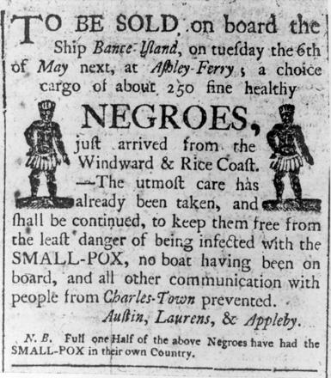
Africans in America
BASIC HUMAN INSTINCT
TO WANT TO BE
FREE
The colonies live off slavery
North AND South—but primarily South
Harsh conditions—especially in South
VA-some proximity of fields left some time to see friends, family
Rising female slave population—reproduction
VA relies less on slave trade—the South still uses it
Up to 48,000 slaves in northern colonies
Work for artisans; work agriculture
Some evolve into carpenters, bricklayers, etc.
African culture begins to grow and spread
Speech, religion, music, stories
Gullah → goober, gumbo, voodoo
Ringshout dance
Banjo, bongo, etc.
New York Slave Revolt, 1712
A revolt of slaves in NY. They killed nine whites and injured six others.
70 Africans arrested. 27 put on trial. 21 executed.
2) Stono Rebellion (South Carolina), 1739
Fifty Africans march to FL; are stopped—more tightly controlled in South than in the North

Slide 7
Colonial Society
Still rely on agriculture—as time goes on, less and less land is available.
Split land up—smaller profits. Hire self out as workers to make ends meet.
Land of equality and opportunity
When compared to…
Except for…
Social / class distinctions still present
Most Americans modest farmers
The opportunity to “rise” – American Dream
Merchants’ lifestyle
School and Church seating
The richest 10% own 66% of the land
Almshouses built—still better than England!
The Scarlet Letter…P
Rich Southerners’
power seen in amount of slaves owned.
Indentured Servitude still used; also, Paupers and Convicts—involuntarily shipped to America
*becoming less English by the day!
Some Southern territories plead with Britain to stop the flow of slaves from Africa—Britain rejects the ideas!

Slide 8
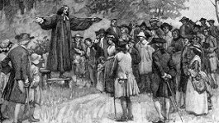
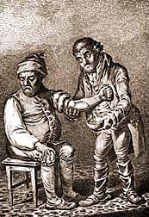
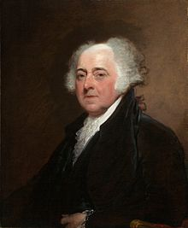
Society and Jobs in Colonial America
Priests—highly regarded and looked up to in society
Will play a huge role in the coming years.
Physicians—poorly trained.
1765-First medical school established
Use of bleeding to “cure”
Many, many deaths to disease and epidemics
Lawyers
“Windbags” not to be trusted
On par with drunks and brothelkeepers

Slide 9
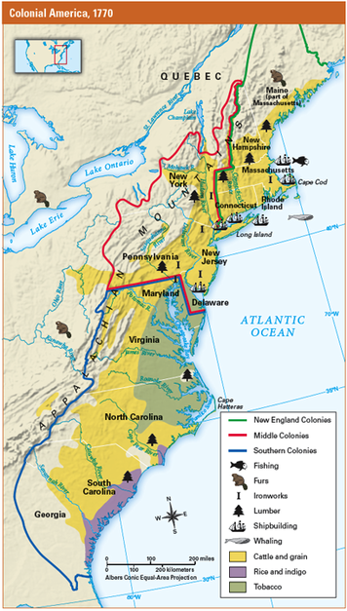
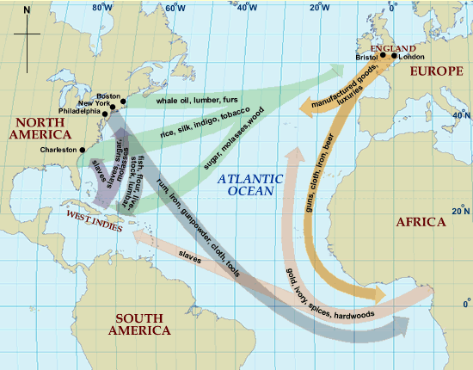
The Economics of Colonial America
Remember the principle of mercantilism*
England is in a “slump” in terms of population—the colonies have a surplus population. They look to outside markets (countries) to trade with in order to make money—Primarily France.
Molasses Act passed (1733)—leads to smuggling.

Slide 10
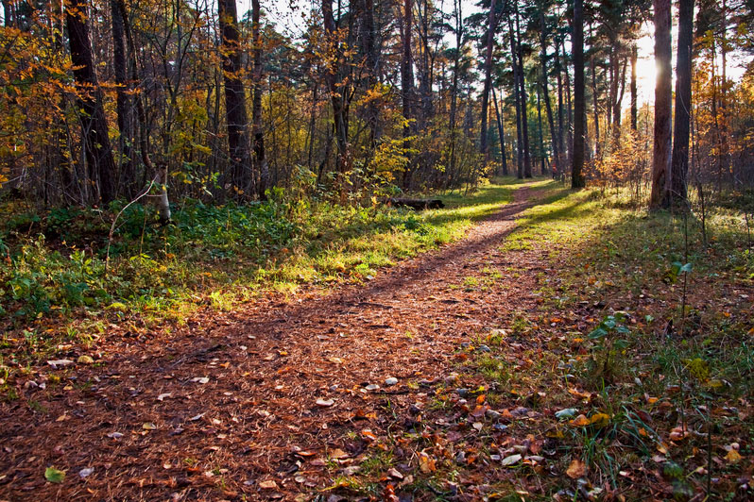
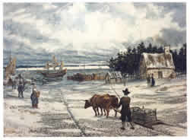
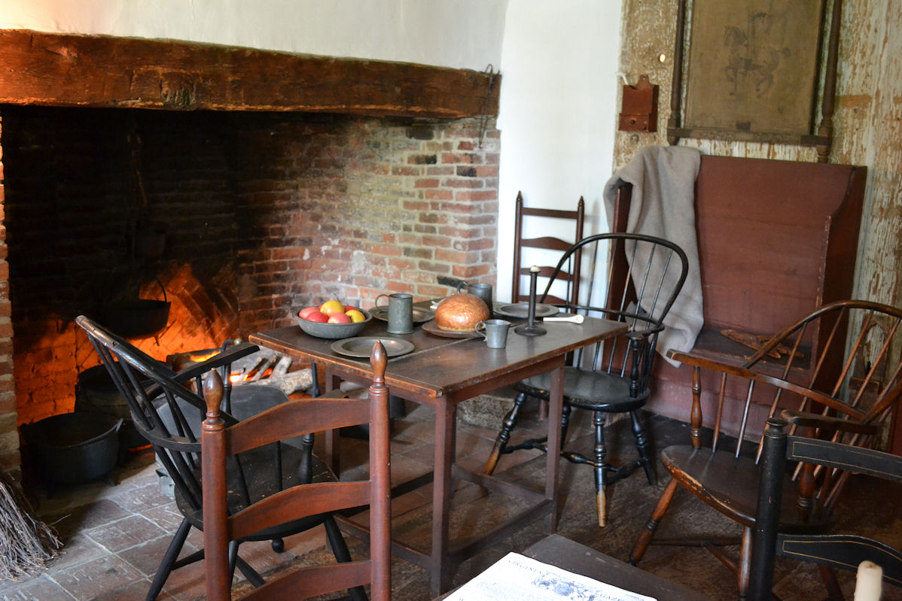
Navigating Colonial America
Not until 1700s that major cities were connected by road
Nine-day journey from Boston to Philadelphia
Twenty-nine days before news of Declaration’s signing reached South Carolina from Pennsylvania

Slide 11
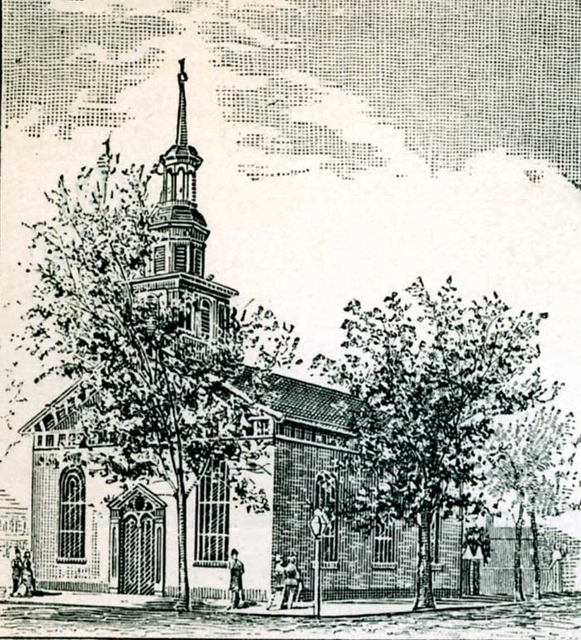
New England Churches
Two tax-supported churches by 1775
Anglican and Congregational
Many do not worship
Even in colonies with established religions
Church of England
GA, NC, SC, VA, MD, NY
Port of Authority for the Crown
Still resistance to the Church overall
Shorter, more secular sermons

Slide 12
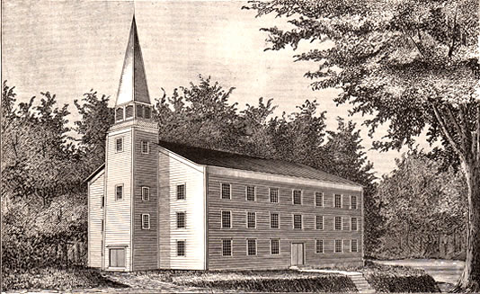
New England Churches
Congregational Church
Branch of Puritan Church
Present in NE, except for Rhode Island
Other denominations exist, but taxes go to support the Congregational church (for the most part)
Ideas spread of a revolution against Britain
Many preach for sedition
Anglican priests supported the King

Slide 13
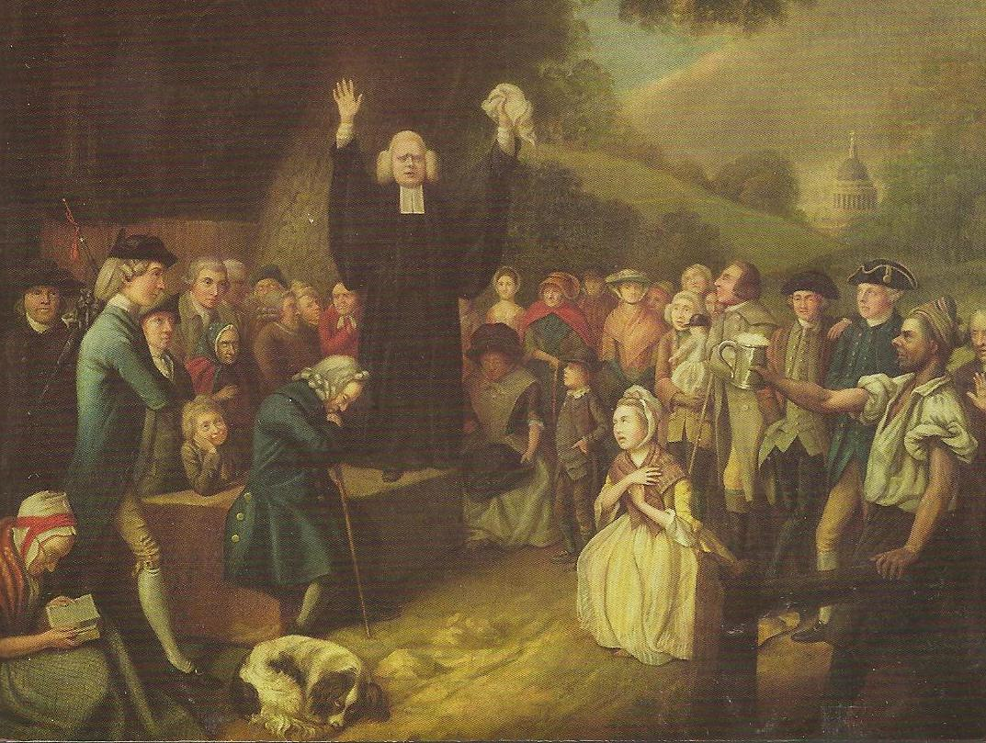
The Great Awakening
Church membership and participation is dwindling
“Dead dog” preachers
Hellfire sermons
Strict doctrine vs. liberal membership requirements
Arminianism—Jacobus Arminius
The Grace of God
Jonathan Edwards
Sinners in the Hand of an Angry God
Road to hell paved with skulls of unbaptized
George Whitefield
“Actor” Preacher—spoke to people’s emotions
Old Lights vs. New Lights—approach the God and Church
Schisms from Congregationalist and Presbyterians
Missionary work among Native Americans
Impacts schools of higher learning
Reaches all Americans—rich and poor

Slide 14
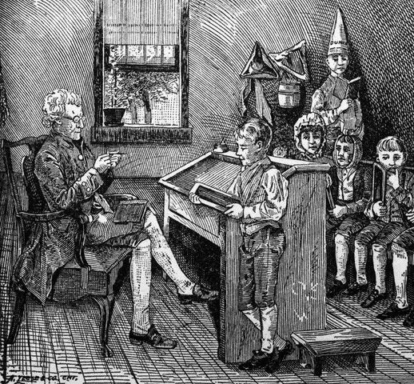
Education in the Colonies
Nine colleges established during colonial era—around 200 students total.
*Ben Franklin establishes the first denomination-free school
“Stronger” education in the North—the South’s geography and sparse population made it difficult to provide a decent school system.
Some schools are tax-supported, some are privately operated
Wealthy rely heavily on tutors
Schooling existed primarily for males
Improvement—used to be reserved for the rich
Purpose of school is to make good Christians, not critical thinkers or good citizens
Universities aim to make preachers
Schools flourish in NE
Instruction is poor
Time in school and type of schooling varies by location
Primary and Secondary schools
School was similar to church—gloomy, focused on religion and “classic” languages
Severe discipline

Slide 15
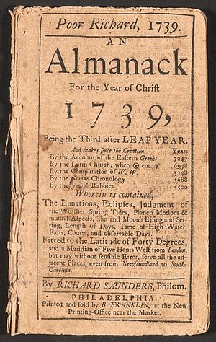
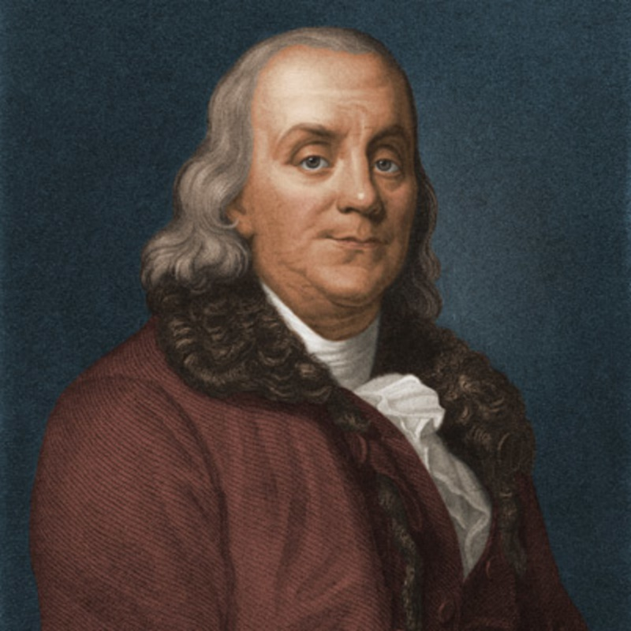
Provincial Culture
Colonial Americans still saw themselves as “British” culturally and artistically
Still largely plantation-based life in America—go to England to get proper schooling
Charles Wilson Peale, Benjamin West, John Singleton Copley
Architecture—largely old world
Literature—Poor Richard’s Almanac—1732-1758
Benjamin Franklin
Most popular book except for the Bible
Short bits of advice on various topics
Thrift, industry, morality, common sense
Ben Franklin: Inventor of…

Slide 16
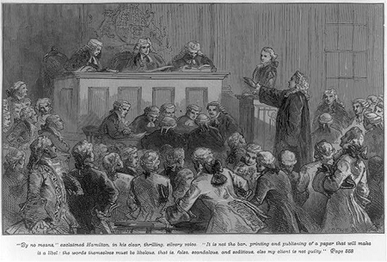
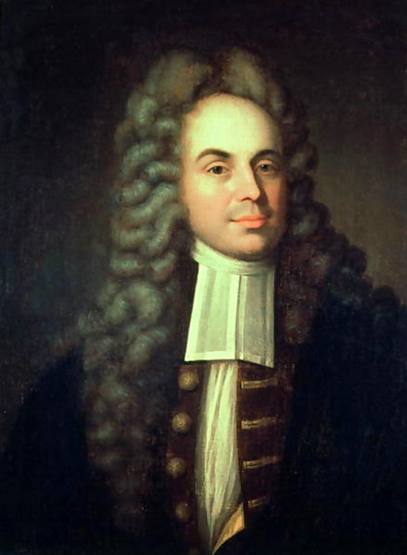
Freedom of the Press
Most Americans aren’t reading
Too poor to buy or busy to read
Access to literature open to wealthy, clergy
Still—some literature out there
Fifty public libraries by 1776
On eve of revolution—40 newspapers in print
Newspapers lag—distance matters!
John Peter Zinger
New York
Criticized the governor of NY
Truth doesn’t matter to judges
Jury still finds him not guilty
Hamilton defending Zenger

Slide 17
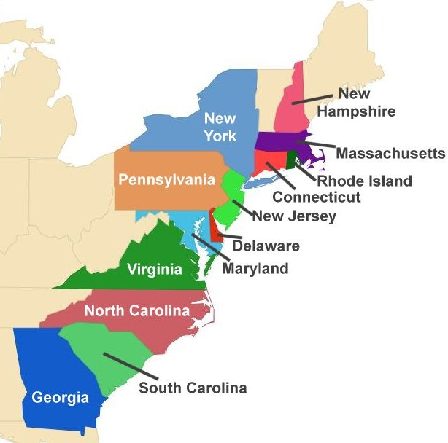
Politics of the Colonies
Three Types of Colonies:
Royal, Charter, Proprietor
This is the text of the box
Eight Colonies had governors appointed by the King
Three had proprietors who chose the governor
Rhode Island, Connecticut elected their governor
Most colonies had a bicameral (two-chamber) legislative body (similar to today’s Congress)
(Upper house appointed; Lower house elected)
Some governors good; some corrupt
Legislature wields its authority by withholding $
Taxation WITH representation
Voting; town meetings, etc.
America still not a true democracy—but getting there

Slide 18
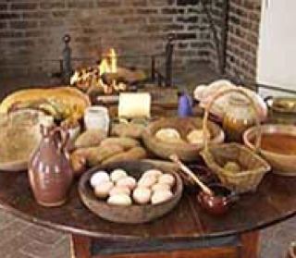
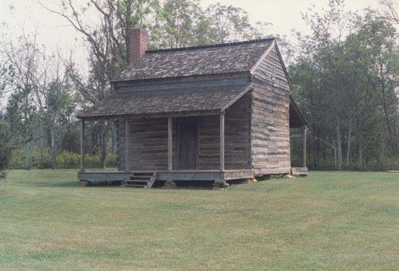
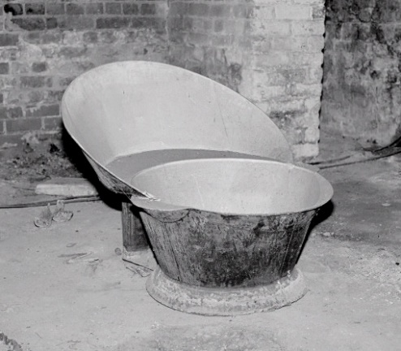
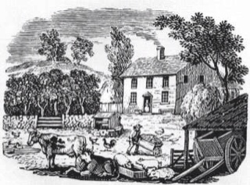
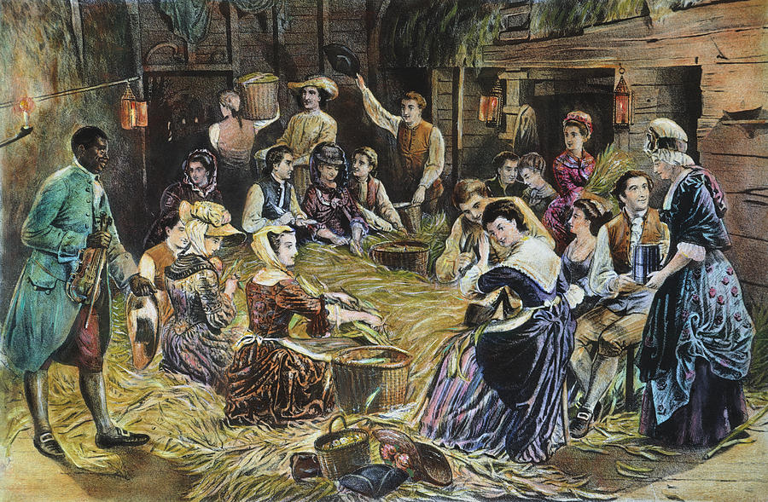
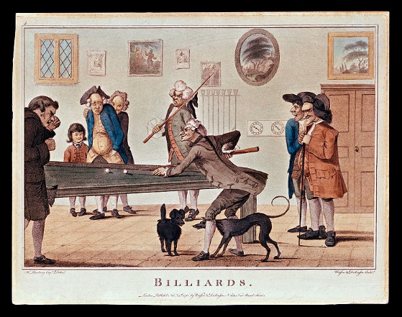
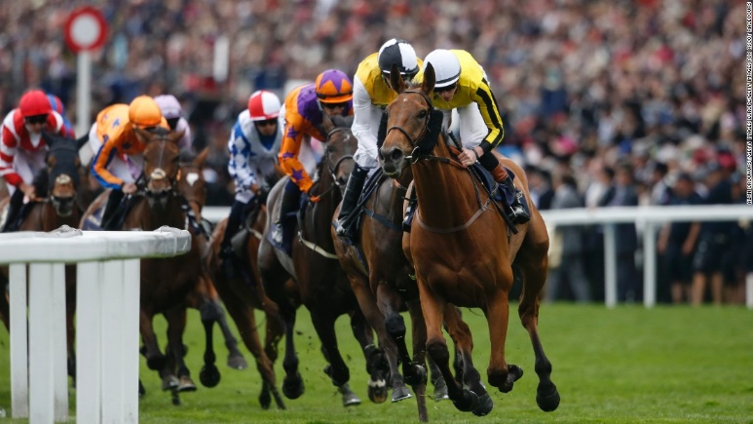
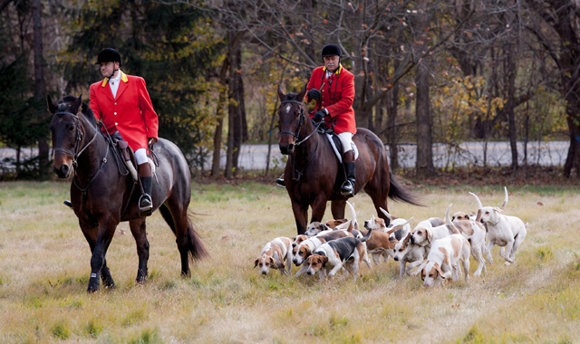
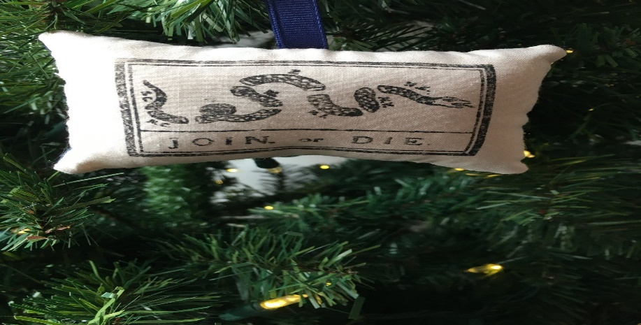
Colonial Life
America is becoming more diverse, yet more alike.
Less Anglican, but more tolerant.
Oh, and distance and time matter.

Slide 19
Chapter Six, Part One
The American Pageant

Slide 20
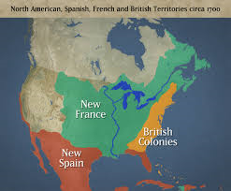
The Duel for North America
England, France, Spain
All major European powers
All want control of the Americas
All participate in various wars
The “first” world wars
Natives and Colonists caught up in the wars

Slide 21
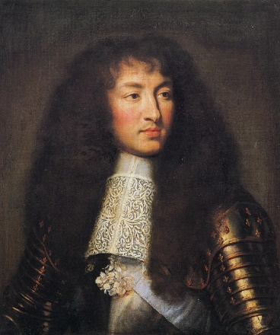
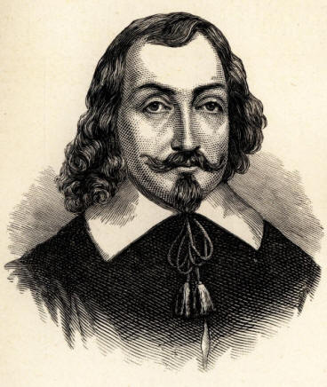
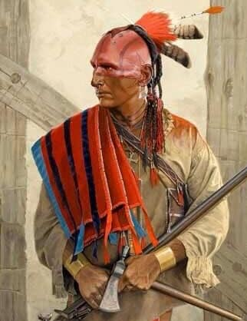
French Canada
France “late to the game” of exploration
French Huguenots
Protestants clash with Roman Catholics
Edict of Nantes (1598)
Peace / toleration of Protestants
Why does it matter?
France will grow as a result
Louis XIV looks to colonize overseas
1608—France lands in Quebec
Samuel de Champlain
Friendly relations with the Natives
Joins Huron Indians against the Iroquois
Iroquois hostile to France and its settling
New France
Autocratic
No right to jury trial (as in English colonies)
Catholic
Slow to grow—no incentive to move
There to compete w/ England and Spain
Source of wealth: beaver
Recruit Indians—die to disease and alcohol
Conflict of beliefs and practices w/ Indians

Slide 22
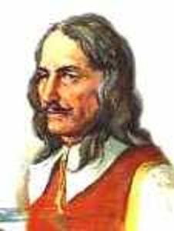
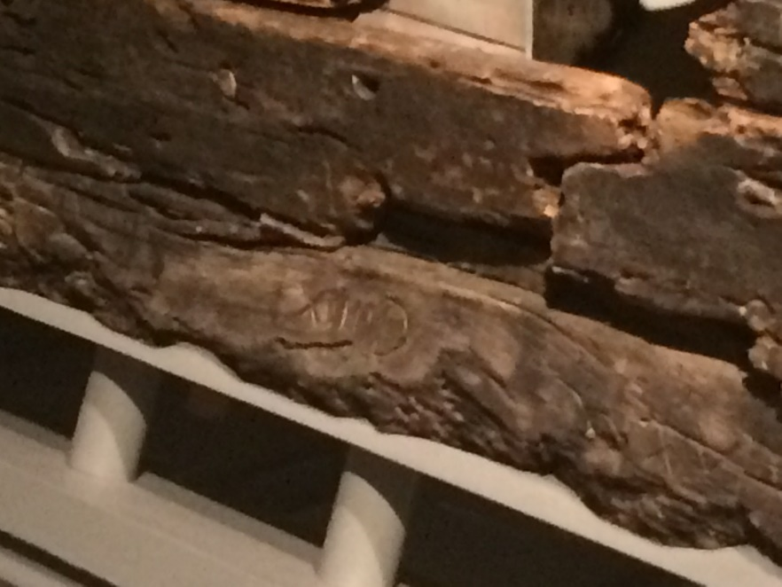
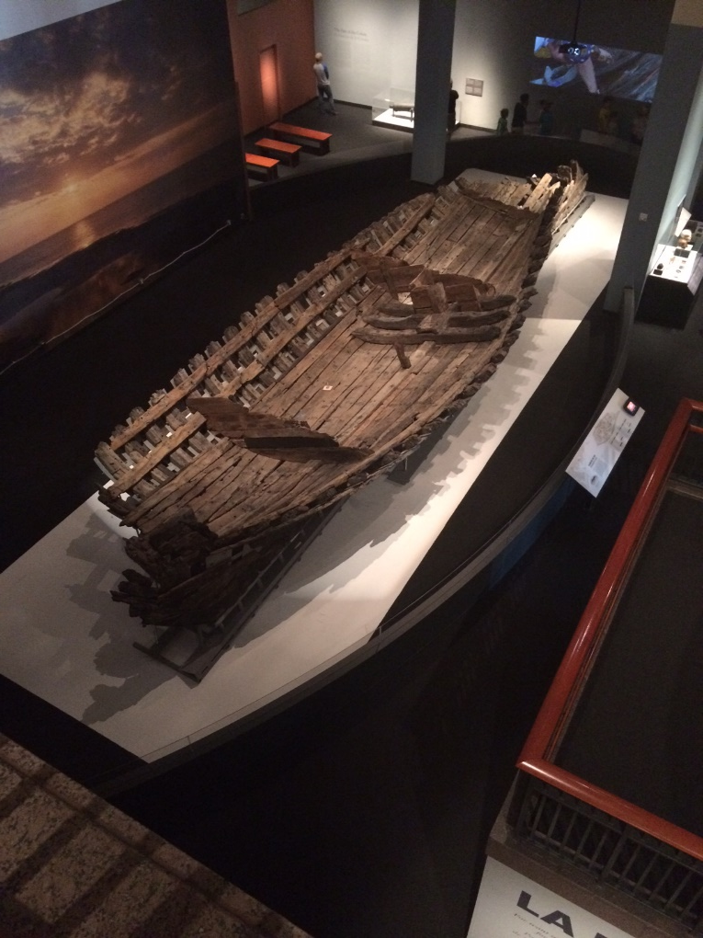
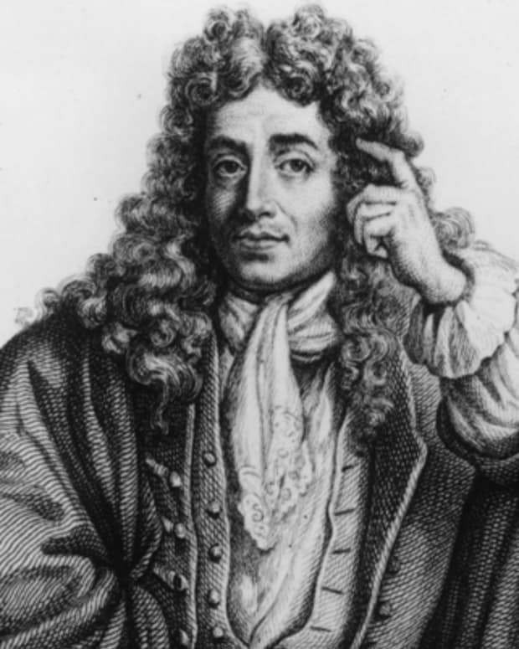
New France Spreads Out
Antoine Cadillac—
Detroit
Robert de La Salle—
Mississippi / Gulf
Louisiana

Slide 23
Fighting for Empire
This is the text of the box

Slide 24
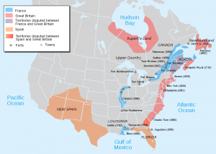
Clash for Empire
Treaty of Utrecht Signed—1713
Britain gains control of:
- Acadia (Nova Scotia)
-Newfoundland
-Hudson Bay
---Period of Peace—
First major clashes for control of North America
King William’s War (1689-1697)
Queen Anne’s War (1702-1713)
British vs. French
Both used Indian allies; did not send their own troops
Guerrilla war
Spain eventually sides with French
British cannot get into Canada
Victory at Nova Scotia
Britain also gets limited trading rights with Spanish America

Slide 25
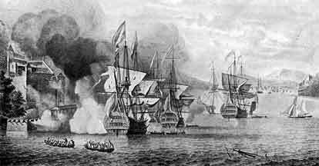
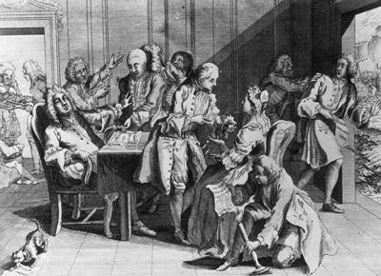
The War of Jenkins’s Ear
Robert Jenkins
British Captain
Encounters Spanish trading authorities
Ear sliced off
“Carry this home to your master, whom, if he were present, I would serve in like fashion”
War of Jenkins’s Ear—1739
British vs. Spanish
Caribbean Sea, Georgia
Comes to be called King George’s War
France allies with Spain
New Englanders invade New France
English capture Louisbourg
Aftermath
British repelled in Caribbean
Spain proves itself capable against Britain
Louisbourg handed back to France—outrage!
France still a dominant player in North America……. and so is Britain.

Slide 26
And That’s Period 2!
Period 1: 1491-1607
Period 2: 1607-1754
Test! (9-25)
Period 2 HIPP (due 9-25)
BAGPIPE (due 9-25)
Google Classroom SAQ 2 (due 9-26)
Period 2 Summary (due 9-26)

